Slide 1
Pitch Deck 2025
PageMe V3
Modern Healthcare Workforce Scheduling & Management
From Medical Residency to Enterprise Healthcare Workforce Management

Slide 2
The Challenge
Fragmented Healthcare Scheduling
Fragmented Systems
Healthcare scheduling is stuck in the past—spread across multiple disconnected tools that don't talk to each other. Legacy platforms focus on logging but fail at intelligent scheduling.
The Cost of Inefficiency
Manual & Error-Prone
Manual scheduling time
3+ days
Compliance tracking is manual and error-prone. Block scheduling—the standard in healthcare—is poorly supported by existing solutions.
Scheduling conflicts per month
15-25%
Administrative Burden
Healthcare workers waste hours on administrative tasks instead of patient care. The result: scheduling conflicts, compliance violations, and burned-out staff.
Compliance violations
High risk
Staff satisfaction impact
Negative

Slide 3
The Solution
Unified Workforce Management Platform
PageMe V3 is a modern, cloud-native platform that unifies scheduling, tracking, and compliance in one intuitive system. Built specifically for healthcare's block scheduling model.
The Impact
75%
Visual Scheduling
Real-Time Compliance
Reduction in scheduling time
Drag-and-drop interface makes complex scheduling simple
Automatic ACGME compliance with instant violation alerts
Zero
Conflict Detection
Cloud-Native
Compliance violations
Real-time conflict detection prevents scheduling errors
Enterprise-grade security with multi-tenant SaaS
100%
Real-time visibility

Slide 4
Product
Core Capabilities
Block Scheduling
ACGME Compliance
Workforce Management
Academic year rotation management
Automatic duty hours tracking
Flexible user attributes (PGY, specialties)
Flexible shift definitions with time windows
Real-time violation detection
Role-based access control
Visual grid interface with drag-and-drop
Compliance reporting dashboard
Time-off request management
Real-time conflict detection
Workload balancing analytics
Multi-organization support
Modern UX
Enterprise Features
Intuitive web-based interface
Multi-tenant SaaS architecture
Technology Stack
Mobile-responsive design
Auth0 secure authentication
Backend: FastAPI + PostgreSQL
Real-time updates & notifications
Audit trails & data integrity
Frontend: React 18 + TypeScript
Advanced filtering & search
API-first for integrations
Auth: Auth0 Enterprise
Cloud: Scalable SaaS

Slide 5
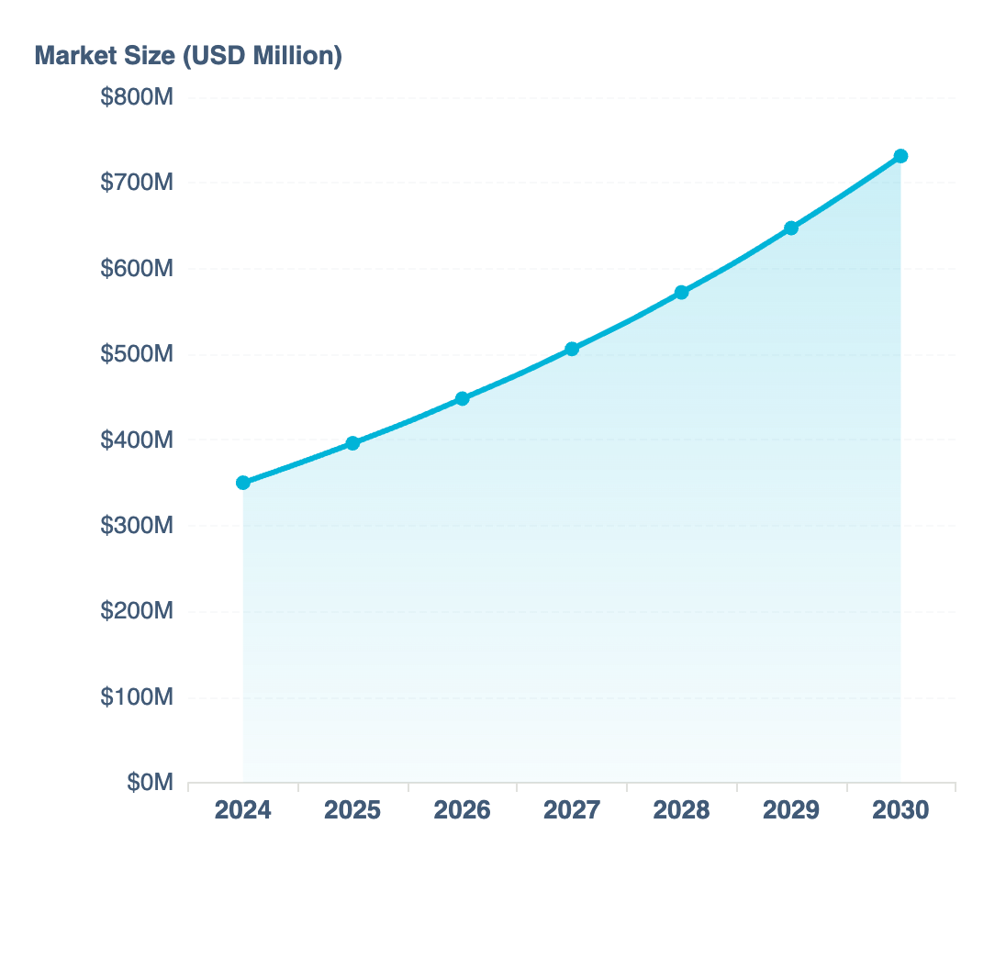
Market
A $731M+ Market Opportunity
Market Size & Growth
Market Growth Trajectory
2024 Market Value
$350M
2030 Projection
$731M
CAGR (2024-2030)
13.1%
Cloud Adoption
69%
Target Segments
1
Medical Residency Programs
13,762 ACGME-accredited programs, 167,000+ active residents
2
Nursing Departments
Every hospital, clinic, and health system nationwide
3
Healthcare Workforce
20M+ workers in the US healthcare system

Slide 6
Competition
Competitive Advantage
vs. New Innovations
vs. Legacy Systems
Superior scheduling + tracking in one platform, not just logging
Modern UX with intuitive design
Visual interface vs. data entry forms
Cloud-native architecture, no on-premise
Real-time compliance vs. post-hoc reporting
Real-time updates and notifications
Modern UX vs. legacy interface
API-first for seamless integrations
vs. Generic Scheduling
Technology Moat
Healthcare-native with block scheduling
FastAPI + React modern stack
ACGME compliance built-in
Multi-tenant SaaS architecture
Rotation management for medical education
API-first extensible design
Healthcare workflows out of the box
Enterprise security with Auth0

Slide 7
Growth Strategy
Three-Phase Expansion
1
Medical Residency
2
Nursing Departments
3
Enterprise Health Systems
Current Focus
Near-Term
Expansion
Target Market
Target Market
Target Market
13,762 ACGME-accredited programs with 167,000+ active residents
Every hospital, clinic, and health system with nursing staff
Multi-facility health systems and IDNs
Key Features
Key Features
Key Features
Multi-department scheduling
ACGME-compliant scheduling
Unit block rotations
Cross-functional workforce
Block rotation management
Shift scheduling & staffing
System-wide analytics
Duty hours tracking
Staffing ratio compliance
Advantage
Goal
Advantage
Multi-tenant architecture enables single-platform deployment
Validate product-market fit and establish brand recognition
Block scheduling is universal in nursing—perfect fit

Slide 8
Technology
Modern Architecture
Modern Tech Stack
Enterprise Security
Backend
Frontend
Auth0 integration with enterprise SSO support
FastAPI (Python)
React 18 + TypeScript
Role-based access control (RBAC) for fine-grained permissions
High-performance async framework
Modern UI components
Audit trails for compliance and data integrity
HIPAA-compliant data handling and storage
Database
Auth
PostgreSQL
Auth0 Enterprise
Enterprise-grade relational DB
Role-based access control
API-First Design
RESTful APIs for seamless EHR integrations
Cloud-Native SaaS
Extensible architecture supports custom workflows
Webhook support for real-time notifications
Multi-tenant architecture with organization-based isolation
Third-party integrations with payroll, HR systems
Scalable cloud infrastructure for enterprise workloads
Automatic updates with zero downtime deployments
Elastic scaling to handle peak usage periods

Slide 9
Business
Business Model
SaaS Subscription Model
Revenue Streams
Basic
Professional
Enterprise
Multiple revenue channels for sustainable growth
Small programs
Mid-size departments
Health systems
Core scheduling & compliance
Advanced features & analytics
Full platform + API access
Subscription Revenue
Primary
Monthly/annual SaaS subscriptions
Implementation Services
Implementation
Secondary
One-time setup and training fees
Onboarding & training
Data migration
API Access
Enterprise
Customization
Ongoing support
Premium integrations and custom development

Slide 10
Roadmap
Product Roadmap
Q1
Enhanced Nursing
Q2
Mobile App
Q3
Advanced Analytics
Q4
AI Optimization
Certification Tracking
Native Apps
Predictive Insights
Auto-Scheduling
Expanded user attributes for ACLS, PALS, and specialty certifications
iOS and Android applications for on-the-go access
ML-powered scheduling predictions and recommendations
AI generates optimal schedules automatically
Push Notifications
Conflict Prediction
Staffing Dashboards
Real-time alerts for schedule changes and conflicts
Workload Balancing
ML predicts potential conflicts before they occur
Compliance dashboards for state and federal staffing ratios
Algorithms for fair workload distribution
Mobile Requests
Smart Recommendations
Nursing Workflows
Submit time-off and swap requests from mobile
Executive Dashboards
Automated shift recommendations based on patterns
Specialized workflows for nursing shift management
Leadership views for system-wide analytics

Slide 11
Value Proposition
Why PageMe V3?
One Platform, Multiple Solutions
Better Than Legacy
Scheduling + tracking + compliance unified in one system. No more tool fragmentation. No more switching between applications.
Intuitive UX, real-time capabilities, visual scheduling. Healthcare workers deserve modern tools that make their jobs easier, not harder.
Built for Healthcare
Native support for block scheduling, ACGME compliance, and healthcare-specific workflows. Not a generic tool adapted for healthcare.
Scalable Growth
From residency programs to enterprise health systems. One platform grows with your organization, from single department to entire system.
Modern Technology
Cloud-native, API-first, extensible architecture. Replace legacy systems with future-proof technology that scales with your needs.
Market Differentiation
Block scheduling native
Real-time compliance
Modern UX
Multi-tenant SaaS
Extensible platform
API-first design

Slide 12

The Future of Healthcare
Transforming Healthcare Workforce Management
PageMe V3 is positioned to transform how healthcare organizations manage their most valuable asset—their people. With a massive addressable market, differentiated technology, and clear expansion path, we're building the workforce management platform healthcare deserves.
$731M
13.1%
20M+
Market by 2030
Annual Growth
Healthcare Workers
Join Us in Modernizing Healthcare Scheduling

